Slide 1
Daxi controller codes
Xiyu Yi @ biohub

Slide 2
AO task bundle
Add subtasks
Add timing and trigger
trigger
Write data
Metronome
output
Start
Stop
Write data
trigger
AO channel 1
AO task bundle
AO channel 2
…

Slide 3
DaXiGUI
DaXi Controller modules
Specific to DaXi
Processes pool
processes template?
Think about the relationship between devicepool,
And the devices under hardware...
system
acquisition
ProcessesManager
(DaXi)
Recruited processes
inspection
navigation
Leave for summer interns perhaps.
Over sees everything about DaXi
calibration
alignment
Proceed and pivot along the way!
Device modules
Device pool
General and expandable
DevicesManager (DaXi)
SerialDevicesManager (G)
OrcaFlashV4
Stage
Tentative: Device pool is like the workforce. You “recruit” from the device pool, and “decorate” the devices to match with the instrument/function-requirement.
DirectDevicesManager (G)
LED
Pump
Take orders from the task manager, and manage the devices
Galvo
PiezoStage
Use it as an interface to connect to external resources and. Their APIs
DAQDevicesManager (G)
Laser
Data tools modules
Data tools pool
General and expandable
Use it as an interface to connect to external resources and. Their APIs
Only need the data tools for lite processing. Complicated functions shouldn’t be included.
Offer interface into napari.
DataToolsManager (DaXi)
storage
loading
statistics
Take orders from the task manager, and manage the data
streaming
naming
visualization
display
conversion

Slide 4
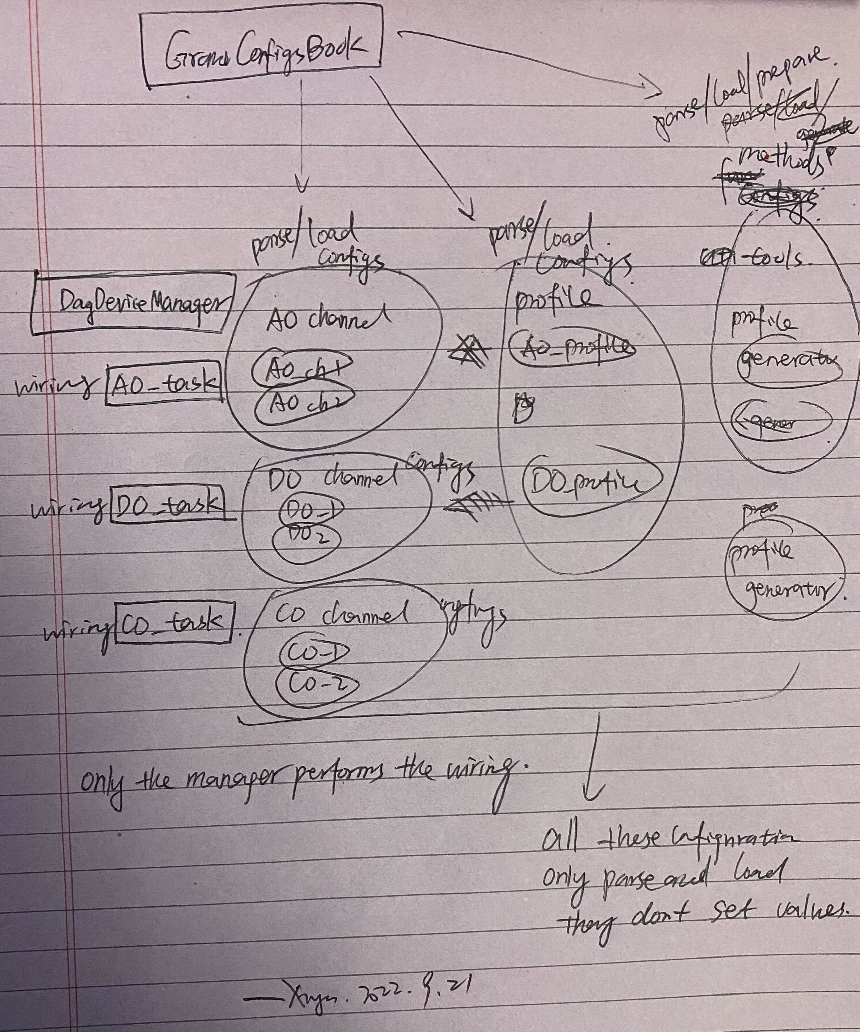
DAQDevicesManager (G)
Manager’s responsibility:
Pre-performance inspection.
In-performance coordination.
GrandConfigsPath
TaskBundleAO
TaskBundleDO
NIDAQConfigsParser
SubTaskAO
Virtual_tools_configs
SubTaskDO
Constants.py
parser
Metronome
Counter

